Slide 1
2.0 Design
2.1 Requirement Specification
2.1.1 Conduct Interview and Surveys
2.2 Hardware Development
2.2.1 Operations Control System (OCS)
2.2.2 Hand-Held Computers (HHCs)
2.2.3 Telecommunications Infrastructure
2.3 Software Developing
2.3.1 Capture Address in Software
2.3.2 Display Census-generated information
2.3.3 Assignment Management System software
2.3.4 GPS receiver
2.3.5 Modem for listers
2.4 Set Operations Infrastructure
2.4.1 Local Census office
2.4.2 Regional Census office
1.0 Planning
1.1 Project Management
1.2 Scope Management
1.3 Cost Management
1.4 Schedule Management
1.5 Task Management
1.6 Human Resource Management
1.7 Communication Management
1.8 Risk Management

Slide 2
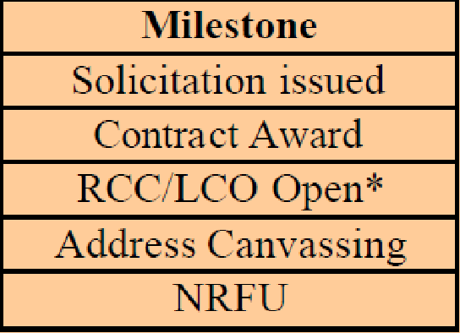
3.0 Testing
3.1 Census Test Address Canvassing Operation
3.2 Census Test Address Canvassing Operation
3.3 Census Dress Rehearsal Address Canvassing Operation
4.0 Implementation
4.1 Implement FDCA
4.2 Ensure system is working
5.0 Closing
5.1 Project sign-off
5.2 Post Implementation Review

Slide 3
Scope Management Failure
1. Ineffective business analysis
2. No requirements performance checking criteria

